Slide 1


Harmonizing Safety & Security in the Aviation sector
November 2021

Slide 2



Lam Lha is the Tibetan Goddess of Travel and Worldly Protector who rode on the back of a golden bee.
We support worldly protectors. And bees are cross-pollinators —just like us. Appropriate, no?

Slide 3




OUTLINE
Security / Safety : Key Elements
Cybersecurity
Dangerous Goods Regulation
SMS & SEMS

Slide 4
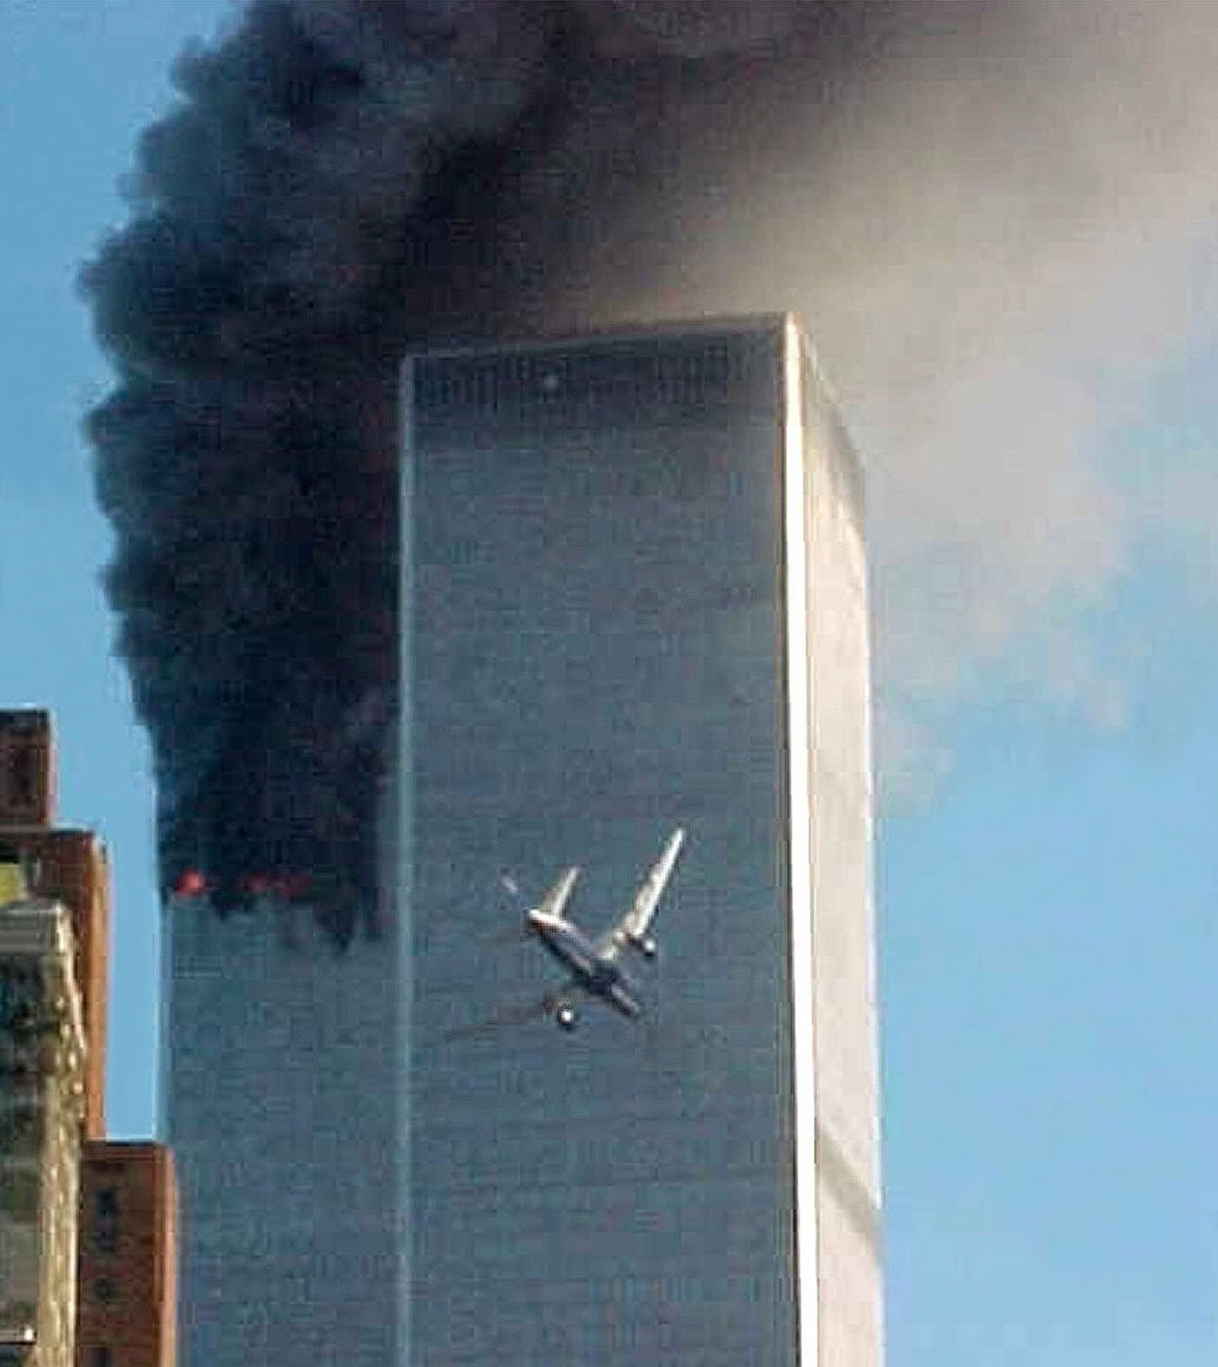
WHAT IS AVIATION SECURITY?
Security / Safety : Key Elements
One definition of aviation security provided by the International Civil Aviation Organization* (ICAO):
“Safeguarding civil aviation against acts of unlawful interference. This objective is achieved by a combination of measures and human and material resources.”
-- ICAO Annex 17
*International Civil Aviation Organization (ICAO) - Specialized agency of the United Nations, coordinates the international civil aviation regulations and policy

Slide 5
WHAT ARE UNLAWFUL INTERFERENCES?
Security / Safety : Key Elements
According to ICAO Annex 17, unlawful interferences include:
  unlawful seizure of aircraft,
  destruction of an aircraft in service,
  hostage-taking on board aircraft or on aerodromes,
  forcible intrusion on board an aircraft, at an airport or on the premises of an aeronautical facility,
  introduction on board an aircraft or at an airport of a weapon or hazardous device or material intended for criminal purposes,
  use of an aircraft in service for the purpose of causing death, serious bodily injury, or serious damage to property or the environment,
  communication of false information such as to jeopardize the safety of an aircraft in flight or on the ground, of passengers, crew, ground personnel or the general public, at an airport or on the premises of a civil aviation facility.
The list above is not exhaustive, ICAO’s member states continue to identify unlawful interferences based on emerging threats
  For example, in 2010, the ICAO Diplomatic Conference held in Beijing classified attacks on aviation cyber networks or “Cybersecurity” as an unlawful interference.

Slide 6

WHAT IS AVIATION SAFETY?
Security / Safety : Key Elements
One international definition is also provided by the International Civil Aviation Organization (ICAO):
“The state in which risks associated with aviation
activities, related to or in direct support of the
operation of aircraft are reduced and controlled to
an acceptable level.”
-- ICAO Annex 19

Slide 7
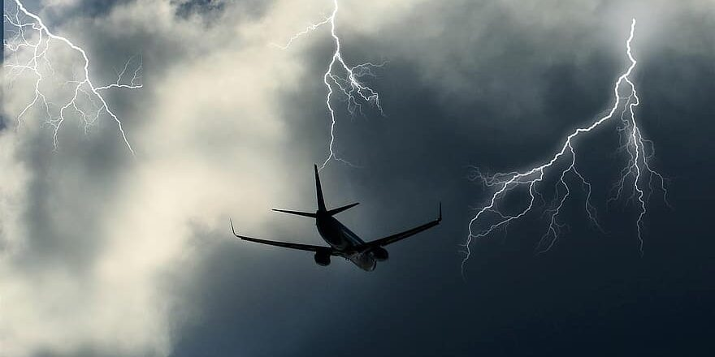
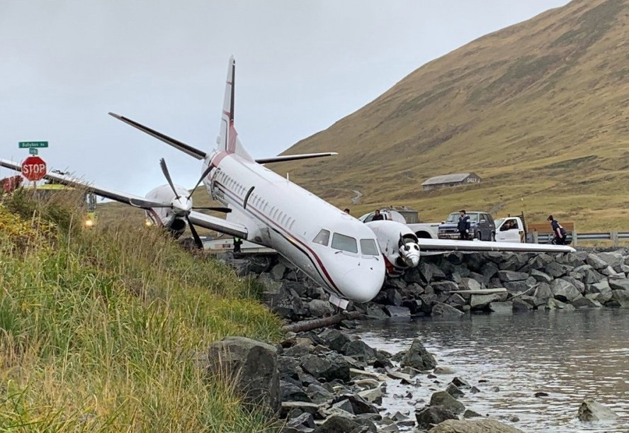
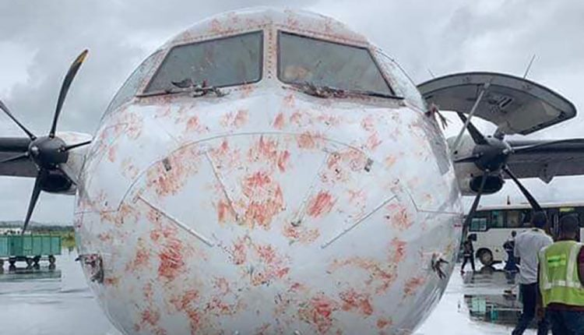
WHAT ARE SAFETY INCIDENTS?
Security / Safety : Key Elements
Meteorological issue
Equipment failure
Bird strike
Fire on board
Human error

Slide 8
CURRENT ISSUES IN AVIATION FOR HARMONIZING SAFETY & SECURITY
Security / Safety : Key Elements
Difficulties:
  Safety & Security Organizations are subject to distinct regulations
  Different international, regional and national stakeholders
  Newer threats such as Cybersecurity effect aviation safety and aviation security - forcing the organizations to work together
  Certain issues that were traditionally categorized into the safety bucket are now also considered security concerns – for example, dangerous goods
Consequences:
  In some areas, safety regulations and practices are more advanced than security – for example, cybersecurity: aircraft manufacturers have had to comply with the regulations that have been put in place for safety (National Institute of Standards and Technology (NIST) standards, etc.); there is need for security to catch up and use examples of how to design programs and enforce compliance from the safety organizations
  Lack of communication between the 2 environments
  Competition between units and reluctancy to collaborate at operational level

Slide 9
CURRENT SOLUTIONS IN AVIATION FOR HARMONIZING SAFETY & SECURITY
Security / Safety : Key Elements
Solutions:
  Creating ad-hoc working groups
    In the cybersecurity sector, International Air Transport Association (IATA) has brought together experts in safety and security from their member states to share expertise, common solutions/approaches, and issues they are facing to help create regulations at the operator level to help address the topic.
  Promoting initiatives from a sector to another when applicable.
    An example of this includes Security Management System (SEMS), inspired by the Safety Management System (SMS).
    In the aviation industry, the SMS has been in place for a long time enforced by inspection/audits.
    SEMS right now is not regulatory, only provides guidance and recommendations on how to implement.
    Working groups have been formed to develop a framework for implementing SEMS
  Continually evaluating emerging threats as potentially new issues on their own with both safety and security implications.
    For example, dangerous goods is a category on its own that must be addressed by both safety and security organizations

Slide 10
MIXING EXPERTS IN AD-HOC INITIATIVES:
THE EXAMPLE OF CYBERSECURITY
Cybersecurity
Cybersecurity is a well-known topic in the aviation safety realm but remains an emerging threat for security organizations in terms of established regulations and mitigation strategies.
  Vulnerabilities have been identified in Air Traffic Management systems, aircraft, and airports.
A more robust background exists in the safety environment due to aircraft manufacturer’s experience in that domain.
Consequently, international and regional security stakeholders are attempting to benefit from existing safety standards to avoid duplication and inconsistencies.
To encourage cooperation between safety and security stakeholders, government officials and airline/airport operators are promoting ad-hoc initiatives that bring together experts from the two separate environments.
AN EXAMPLE
ICAO issued guidance to all member states in 2020: All member states should develop a strategy on cybersecurity
      ICAO urges its member states to ensure coordination at the state level between civil aviation authorities and competent national authorities for cybersecurity.
      It also encourages these stakeholders to establish appropriate coordination channels with industry.
      ICAO includes cybersecurity in its national civil aviation safety and security programs.
In practice ---
At national level, member states have gathered experts from safety and security around the table to define national priorities and draft regulations or guidance for operators.
At airports level, airports have adopted the same model to get safety and security experts to work together to develop internal security governance.
These working groups lead to experience sharing and help to avoid “reinventing the wheel” in the security environment which moves the initiatives forward faster.

Slide 11
PROMOTING INITIATIVES FROM ONE SECTOR TO ANOTHER: THE EXAMPLE OF SEMS
SMS & SEMS
The management of safety in aviation has existed for a long period of time. The implementation of a Safety Management System (SMS) based on regulatory compliance and available for inspection is expected from airports and airlines.
The same formality of practice, does not currently exist in the security space. This lack of definition leads to difficulties in identifying a coherent strategy and in the resolution of non-compliance (certain non-compliance are not fixed or are recurrent).
Therefore, the aviation community has agreed to develop a Security Management System (SEMS), based on the safety experience.
One of the goals for developing SEMS is to inculcate a Security Culture using a top-of-mind, risk-based approach instead of staying in a reactionary posture in aviation similar to the Safety Culture that is already prevalent in the industry
Definitions
SMS – manual for ICAO member states to implement safety measures, used for inspection
SEMS – manual, aviation tool can be used by airports, airlines, or other stakeholders to manage security measures implementation in an operational way

Slide 12
PROMOTING INITIATIVES FROM ONE SECTOR TO ANOTHER: THE EXAMPLE OF SEMS (CONT.)
SMS & SEMS
The implementation of a SEMS enables organizations to:
  promote a strong security culture;
  foster a dynamic and risk-based approach to security;
  effectively identify, manage, and mitigate security risks in a consistent and proactive manner;
  focus on performance, results, and impacts;
  allow oversight to become increasingly risk-based and data-driven; and
  promote effective internal and external partnerships, collaboration and cooperation.
Adapting the SEMS practice from the safety sector is a big step for the security. If IATA, and groups like them, make SEMS a requirement for its members, airports will look to this tool for guidance on implementing robust security programs.

Slide 13
CONSIDERING EMERGING THREATS AS THEIR OWN TOPIC: THE EXAMPLE OF DANGEROUS GOODS
Dangerous Goods Regulation
Another consideration regarding the space between security and safety in the aviation environment deals with considering emerging threats as a new and independent subjects, not categorized as just a safety or security issue but something that needs to be considered by both (and possibly other) organizations.
An example of this is dangerous goods transport.
  Dangerous goods are articles or substances which are capable of posing a risk to health, safety, property, or the environment (i.e., Lithium Batteries)
This topic is a major issue for airlines, which are responsible for the control of these products. It can lead to serious damage in the case of an incident (fire, explosion, aircrafts out of service, etc.).
  For example, it is possible to imagine people voluntarily introducing such substances to the aviation environment and committing acts of unlawful interference. It is also reasonable to see the need for safety measures being in place to prevent the accidental introduction of these items.
Dangerous goods was once considered to be part of aviation security and safety yet was too specific to be included solely in one or the other.
It has since been decided to create a distinct field for dangerous goods with a specific regulation between security and safety, that prescribes measures covering both areas.

Slide 14
CONCLUSION
The harmonization of safety and security organizations is underway in the aviation environment as seen in the examples presented above:
  in cybersecurity, new guidance and management systems , and emerging threats being identified as separate topics to be addressed from both perspectives.
Best practices such as:
  utilizing working groups of diverse experts sharing their respective experience to reach solutions as well as increase interorganizational communication and information-sharing,
  promoting the use of existing safety infrastructure and frameworks to further security practices and culture, and
  working to adopt regulations that strengthen both organizations -
all contribute to a higher level of safety and security in the space aviation stakeholders are charged to protect.

Slide 15





+32474980398
ebidwell@lam-lha.com
MGUALINO@LAM-LHA.COM
lam-lha.com

